Slide 1
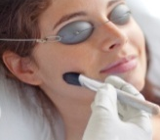
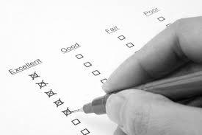
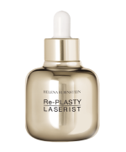
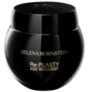
FROM AESTHETIC MEDICINE TO HR SKINCARE EXPERTISE TRAINING MODULE
AESTHETIC MEDICINE EXPERTISE
PROTOCOL EXPERTISE
DAY 1
DAY 2
DAY 3
DAYS 4 & 5
PART 1:
SKIN
BIOLOGY
PART 2:
AESTHETIC
MEDICINE
PROCEDURES
AND HR
SOLUTIONS
PART 3:
REMINDER OF
CUSTOMER
CIRCLE
+ SALES
SCENARIO
PART 4:
EVALUATION TEST:
Knowledge
Sales
scenario
PART 5:
Re-PLASTY 15’/ 30’
PROTOCOL
TRAINING
PART 6:
Re-PLASTY 1 & 2hr
PROTOCOL
TRAINING
2hrs 30 mins
4hrs
4hrs
4hrs
8hrs
at least 16hrs
Mandatory:
Local aestheticians must be trained by international aesthetician, Emmanuelle Foucaud
AWARDING OF
INSTANT COSMETIC INTERVENTIONS - Re-PLASTY DIPLOMAS APPROVED BY LACLINIC-MONTREUX
Notes:
1
1
1
1

Slide 2
FROM AESTHETIC MEDICINE TO HR SKINCARE EXPERTISE TRAINING MODULE PRESENTATION
TARGET: HR BA’s / Personal Beauty Expert
DURATION: 5 days (2 days of “expertise in aesthetic medicine” theory with role plays and evaluation; 1 day of 15’-30’ protocols; 2 days of 60’ and over protocols)
OBJECTIVES: On completion of this training course, BA's must:
- Know about skin biology,
- Know the difference between aesthetic medicine and aesthetic surgery,
- Know how to talk about the various aesthetic medicine procedures and make the links with products in the Re-PLASTY range,
- Sell and know how to explain the Re-PLASTY range (hook, results, technology, price selling points, etc.).

Slide 3
FROM AESTHETIC MEDICINE TO HR SKINCARE EXPERTISE TRAINING MODULE PRESENTATION
PROGRAM:
THEORY (DAY 1):
- PART 1: Skin biology (2hrs 30)
- PART 2: Aesthetic medicine procedures and HR solutions (4hrs)
THEORY (DAY 2):
- PART 3: Customer circle, role play on Re-PLASTY sales scenarios (4hrs)
- PART 4: Evaluation test: knowledge on the whole module + sales scenario (3hrs)
PRATICAL (DAY 3):
- 15’/30’ PROTOCOLS: Mesolift, HD Peel, Laserist, Pro Filler
PRACTICAL (DAYS 4 and 5):
- Cabin PROTOCOLS: "Re-PLASTY Personal Treatment" (2hrs), Mesolift, HD Peel, Laserist, Pro Filler (1hr)
AWARDING OF INSTANT COSMETIC INTERVENTIONS - Re-PLASTY DIPLOMAS
DOCUMENTS GIVEN TO BA's:
- Skin diagram with labels (only for internal use) + notes on skin biology
- Sheet “4 reasons to use products from the Re-PLASTY range - link with aesthetic medicine”
- Hook sheet for the Re-PLASTY range and for each Re-PLASTY product
- Instant Cosmetic Interventions- Re-PLASTY Diploma (only for BA's who pass the test)

