Slide 1
WELCOME
Re-PASTY PRO FILLER SCENARIO
NEW CUSTOMER
Notes:
1
Click on the active zone to start the film.

Slide 2
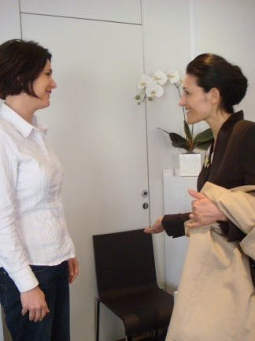
WELCOME (CLASSIC)
WHAT TO DO
Stand in front of the customer.
Smile.
Hold the brand book (or the iPad) and run through the brand photos with the customer,
presenting the brand message.
At this time, invite her to be seated
WHAT TO SAY
Good morning/afternoon madam, welcome to HR, the brand with over 100 years of anti-aging expertise.
It was created by an extraordinary woman, Helena Rubinstein, who invented the 1st cosmetic skincare treatments.
She was certain that beauty gives power and that each woman who gives herself the right tools, can be beautiful. We still believe in this “Power Beauty” today.
Our products are developed to the very highest standards. We have an exceptional partnership with LACLINIC-MONTREUX, in Switzerland, which enables us to develop skincare on the very boundary of aesthetic medicine.
I would like to invite you to take a personalised skin diagnosis as you might do in a cosmetic clinic, both on the skin surface and deeper down.

Slide 3
WELCOME (HOOK)
WHAT TO DO
HOOK: Stand in front of the customer while holding the syringe (factice).
Smile.
The customer is intrigued and stops.
Ask the customer if she already knows the brand. If not, present it and move on to the diagnosis stage. If she does, go straight on to the diagnosis stage.
Hold the brand book (or the iPad) and run through the brand photos with the customer,
presenting the brand message.
At this time, invite her to be seated for the diagnosis.
WHAT TO SAY
HOOK: Hello madam, did you know that you can benefit from the effectiveness of an injection of hyaluronic acid in a serum?
It was created by an extraordinary woman, Helena Rubinstein, who invented the 1st cosmetic skincare treatments.
She was certain that beauty gives power and that each woman who gives herself the right tools, can be beautiful. We still believe in this “Power Beauty” today.
Our products are developed to the very highest standards. We have an exceptional partnership with LACLINIC-MONTREUX, in Switzerland, which enables us to develop skincare on the very boundary of aesthetic medicine.
I would like to invite you to take a personalised skin diagnosis as you might do in a cosmetic clinic, both on the skin surface and deeper down.

Slide 4
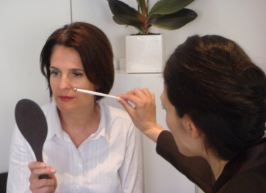
DIAGNOSIS
WHAT TO DO
Invite the customer to be seated.
Ask if she would like you to take her coat or her shopping bags if she is carrying several items.
Explain what the diagnosis will include.
Make her feel comfortable.
Give her the mirror and ask her what she would like to improve about her face today.
Stand behind her both to see what she sees in the mirror and to allow her to answer. Listen to her. Remember what she says.
Be attentive.
Smile. Be pleasant.
Ask her the following questions to gain more information.
To finish, summarise the customer's needs by using the stylus pen to point out the various zones on the face, without touching them.
Present the suitable routine and suggest that she tries the products on her hand.
WHAT TO SAY
Would you like to take a seat so that we can carry out your diagnosis?
May I take your coat?
In order to carry out your personalised diagnosis and recommend the products that match your needs, I am going to ask you a few questions.
Please hold this mirror. When you see yourself in it, can you tell me what you would like to improve about your face today?
What about the eye contour area?
What is your current skincare routine? What kinds of products do you use daily?
What texture do you prefer for your daily skincare? A light cream texture or one that is richer?
With regards to your make-up, what complexion result do you prefer? (natural protection/long-wear/rejuvenating).
You have told me that your concerns are XXXXXXX. In order to respond to these overall anti-aging issues, I would like to recommend the Re-PLASTY PRO FILLER routine.
Would you like to try it on your hand?

Slide 5
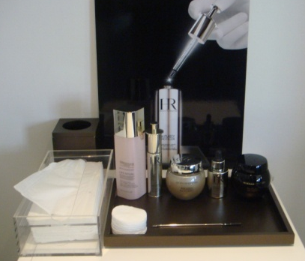
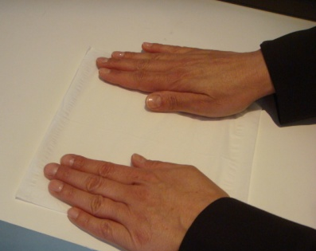
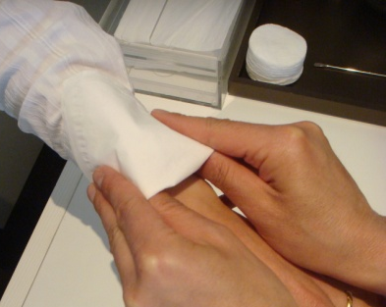
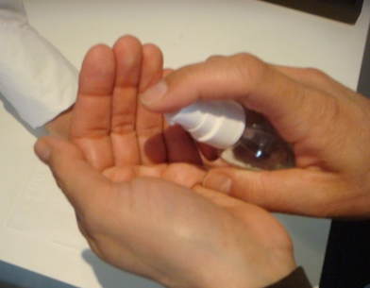
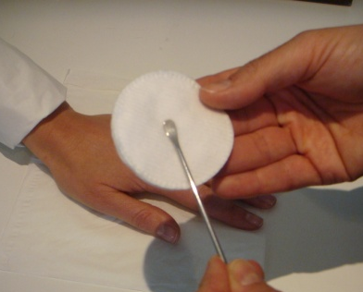
PRODUCT RECOMMENDATIONS
WHAT TO DO
Get the testers and accessories (sanitiser, cotton pads, tissues, spatula(s), rubbish bin) if they are not already available.
Place the testers in order of use on the tray or pad and bring it to the customer: suitable lotion + serum + cream + eye contour + foundation + night cream.
Each time the tester is used, position it back in the same order, turned towards the customer, with its stopper replaced.
Unfold and place a tissue in front of the customer.
Take a second tissue and fold it elegantly, to protect the customer's sleeve.
Sanitise your hands and the Re-PLASTY spatula.
WHAT TO SAY
So here is the full routine that I'm recommending for you to meet the concerns you explained to me.
I'm going to ask you to place your hand on this tissue so that you are comfortable while we try out the textures.

Slide 6
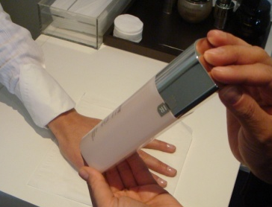
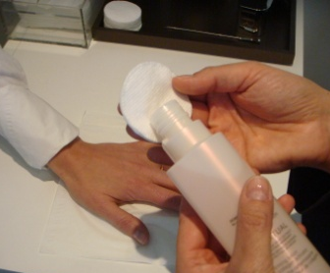
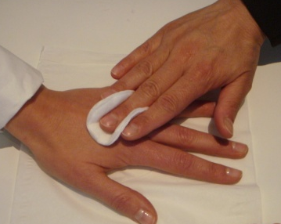
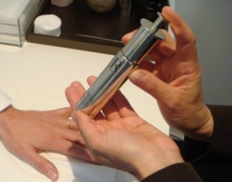
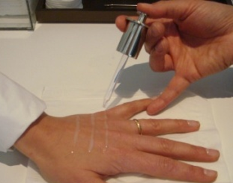
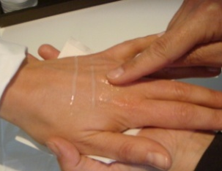
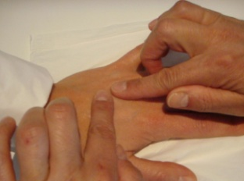
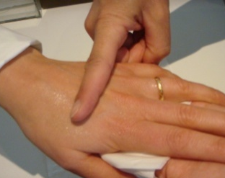
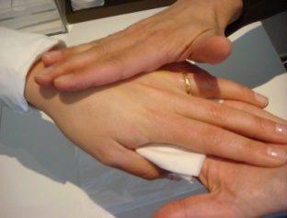
PRODUCT RECOMMENDATIONS
WHAT TO DO
Talk to the customer while applying the product to avoid wasting time.
Present the lotion to the customer.
Take a cotton pad and soak it with lotion.
Wipe the cotton pad soaked in lotion over the outer surface of the hand without touching the wrist or the fingers!
Present the serum to the customer in an elegant manner so that she can read the name while you are talking.
Apply 3 horizontal lines of serum to the customer's hand, ensuring that the dropper does not touch her skin. Close the bottle and place it back in its position.
Place Re-PLASTY PRO FILLER serum back on the tray, then put a tissue folded into 4 in the palm of your hand, and take the customer's hand. Gently massage the hand: spread each line of serum using your index finger; replace the customer's hand and stretch out each line using your two index fingers. Roll your index finger over each line then finish with an enveloping hand massage.
WHAT TO SAY
In order to prepare your skin to discover the Helena Rubinstein textures, I am first going to use the XXX lotion. This is an essential step in your face care routine because it perfects make-up removal and will both prepare your skin and allow the serum to penetrate better.
I'm now going to apply a drop of Re-PLASTY PRO FILLER serum. As we only use the most concentrated and highest performance active ingredients, just a few drops are enough for visibly younger-looking skin. Re-PLASTY PRO FILLER serum replicates the effectiveness of an injection of hyaluronic acid from LACLINIC-MONTREUX. It is highly concentrated in hyaluronic acid to fill your wrinkles, even the very deepest, and provide volume and elasticity for your skin from deep within.
Its fresh texture penetrates completely deep into the heart of your skin and delivers perfect plasticity.
Apply this serum morning and evening to cleansed skin, targeting wrinkles on your face and avoiding the eye contour area.
All your wrinkles, even the very deepest, are filled, and your skin's volume and elasticity are restored.

Slide 7
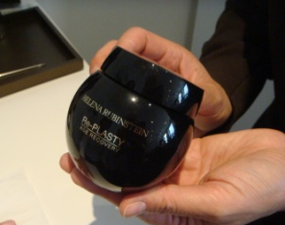
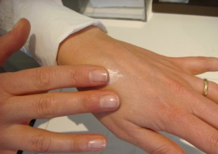
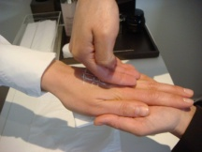
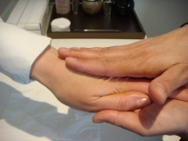
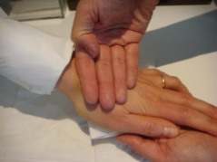
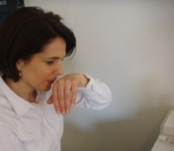
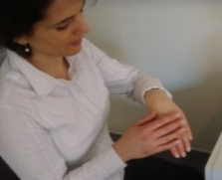
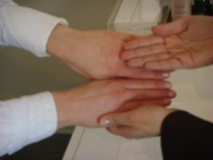
PRODUCT RECOMMENDATIONS
WHAT TO DO
Next, present Re-PLASTY Mesolift cream to the customer in the same elegant manner.
Also present Re-PLASTY AGE RECOVERY cream at the same time.
If the customer wishes to try it, open the jar, take a Re-PLASTY spatula that you have sanitised in front of the customer, and remove a small amount of cream using the rounded end.
Let the customer try it herself by spreading the texture on her own skin.
Then remove a small amount of cream and trace 3 horizontal and 3 vertical lines to replicate a gauze, then replace the cream on the tray.
Massage in as required.
Invite the customer to smell and touch her hand to enjoy the velvety skin effect.
Ask her to compare with her other hand to see the difference.
WHAT TO SAY
In order to maximise the benefits of this routine and to continue correcting your wrinkles, apply Re-PLASTY Mesolift cream during the day, to smooth out your wrinkles and deliver a radiant glow.
But allow me, madam to let you try an incredible cream, with a sumptuous texture that will repair all the scars of aging intensely, during the night, it is Re-PLASTY AGE RECOVERY cream. Would you like me to show it to you?
This night cream will intensely repair your wrinkles, skin damage and blemishes. Apply it in the evening, after the serum, to the face, excluding the eye contour area.
Firstly, I would like to let you discover its sumptuous texture in your own hand.
Its texture and fragrance are unique. What do you think?
I will now give you a short massage to allow you to rediscover the texture.
If the customer is looking for a specific product, insist on this product and the results it delivers, while including it as part of the routine: serum + cream + eye contour + foundation.

Slide 8
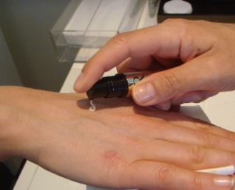
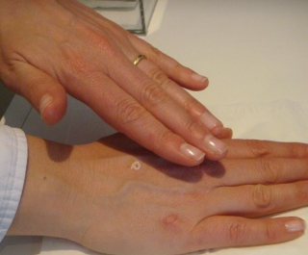
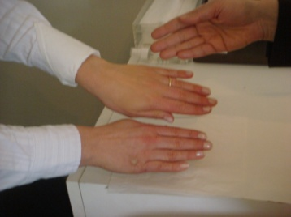
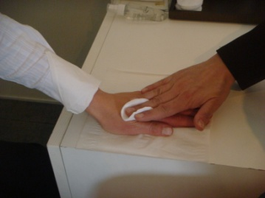
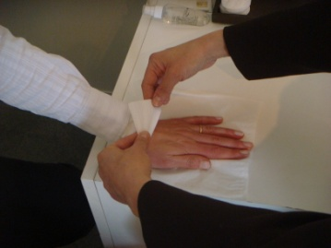
PRODUCT RECOMMENDATIONS
WHAT TO DO
Suggest that the customer tests the texture of the eye contour. If she agrees, apply a tiny amount of product onto her other hand and let her spread the texture herself.
Finally, wrap up with Prodigy Powercell foundation.
Suggest that the customer tries it on the first hand (the one where you applied the face care products) Use a universal shade such as 23.
Place a small amount of foundation on the back of the customer's hand, ensuring that the dropper does not touch it.
Invite the customer to smell and touch her hand to enjoy the result, then invite her to compare her two hands.
When you have finished the texture application, if you have applied the foundation to the customer's hand, take a cotton pad, soak it in lotion and wipe over her hand to remove the foundation.
Remove the protective tissue from her sleeve.
WHAT TO SAY
The skin around the eye contour is much thinner than it is on the face. This area is also under strain from facial expressions, so that is why the product you apply to this fragile zone must be specially adapted. In your case, the ideal product is Re-PLASTY Mesolift, to achieve an anti-aging and smoothing effect, and it should also be used morning and evening.
Did you know that there are other very simple and complementary techniques you can use to leave your skin looking young, radiant and fresh?
You can enhance your complexion while prolonging the benefits of your skincare routine by using Prodigy Powercell foundation.
Right from application, you will love the ultra natural bare skin effect that will leave your skin feeling comfortable all day long, and looking smooth and rejuvenated.

Slide 9
PRODUCT RECOMMENDATIONS
WHAT TO DO
Recap and conclude.
Line up the various products in order of use in front of the customer.
Point to each product when you talk about it, and demonstrate the application techniques
(for the serum application technique, please see the film)
Answer any questions she may have (see training file).
Fill in the diagnosis and products sections on the prescription card (or iPad)
Do not forget the conclusion phrase, which is essential to trigger the act of purchasing.
WHAT TO SAY
The suitable skincare routine for you, madam, is the Re-PLASTY PRO FILLER routine, which will allow you to erase your wrinkles and add volume, elasticity and radiance to your skin, both deep down and on the surface:
Each morning and evening after cleansing, soak a cotton pad with XXX lotion and apply to the face. Then apply Re-PLASTY PRO FILLER Serum using a dropper-syringe on your wrinkles, avoiding the eye contour area. Spread it with your index finger, then smooth and stretch out each wrinkle using your two index fingers over its whole length. Then, use both hands, with your fingers closed, to restructure the volume of your face.
In the morning, use Re-PLASTY Mesolift to lift and illuminate your face.
In the evening, use Re-PLASTY AGE RECOVERY to intensely repair all the signs of aging.
Finally, in the morning, you can enhance the benefits of your routine with a few drops of Prodigy Powercell Foundation.
What do you think?
What would you like to take with you today?
or What would you like to purchase today?

Slide 10
MANAGING PRICE OBJECTIONS
WHAT TO DO
In case of any questions about price:
WHAT TO SAY
Madam, our products may seem expensive, but that is the price to pay for effective results.
Re-PLASTY products will provide instantly visible results through their highly concentrated active ingredients which have been selected for their performance, while ensuring optimum tolerance.
They are developed with LACLINIC-MONTREUX to provide you with skincare products on the borderline with aesthetic medicine, which replicate the most finely-tuned procedures in this field, and offer highly effective results.
For example, after 3 nights of using Re-PLASTY AGE RECOVERY cream, you will achieve the same results as for a post-operative care treatment at LACLINIC-MONTREUX.
In addition, Re-PLASTY products last for 3 months, and are less expensive than opting for aesthetic medicine, which often requires several sessions.
Finally, our products are not only extremely effective, but also present highly sensorial textures, as you have noticed.

Slide 11
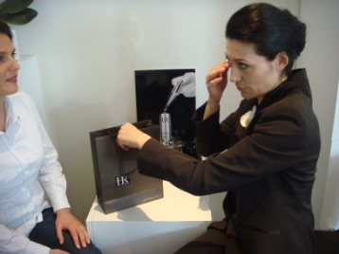
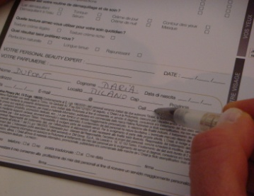
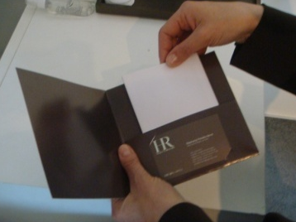
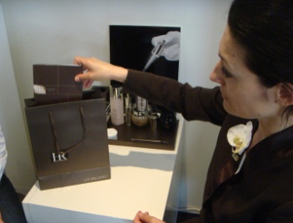
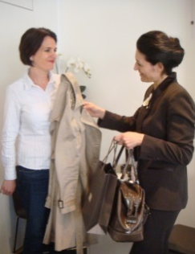
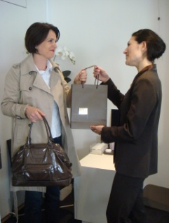
CLOSING A SALE
WHAT TO DO
When the customer has made her choice, go and prepare her products.
Choose suitable samples. Prepare a sample of products that have been recommended but not purchased, prioritizing the must-haves.
Eg. if the customer purchases Re-PLASTY PRO FILLER serum, give her AGE RECOVERY, Re-PLASTY Mesolift cream and eye cream as samples.
The samples must be explained: what they are, how to use them.
Suggest that the customer becomes a member of the customer file. Ask her to fill in the CRM file or fill it in for her (or fill in the file for her using the iPad).
Immediately ask if she would like to do a 15-minute Re-PLASTY PRO FILLER Beauty Intervention or a Focus or suggest that she makes an appointment for another day.
Thank her and reassure her in her choice of products.
Go with the customer to the cash register, give her the products, give her your business card and explain that you will back at the point of sale another time.
Go with her to the exit and smile when she leaves.
WHAT TO SAY
Very good, I am now going to prepare your products.
Here are your products. I would also like to include these samples of XXXX and YYYY so that you can get to know these products at home.
XXX is used.... apply it.... (same for YYYY sample).
I am also going to give you your beauty prescription which lists the products that I presented to you today.
Would you like to be one of our privileged customers and receive exclusive offers, such as..... XXXX (describe the benefits).
I would also like to give you the chance to enjoy a 15-minute Beauty Intervention or a Make-up Focus free of charge, to show how to use your products on your face. When would you be available?
Here are your products, you have made a really excellent choice.
I will be delighted to see you again, I am here until (say when) and will be back again on (give the date). Here is my card, please do not hesitate to call.
Would you like me to call you a taxi?
Goodbye, see you soon.

Slide 12
WELCOME
SCENARIO Re-PLASTY PRO FILLER
CUSTOMER LOOKING FOR A SPECIFIC PRODUCT
In this case, use the first scenario and adapt it slightly. During the recommendation, put the focus on the product she is looking for, while presenting her with a full routine:
(lotion +) serum + cream + + night cream (Re-PLASTY AGE RECOVERY) + eye contour + foundation
Notes:
12
Click on the active zone to start the film.

