Slide 1
WELCOME
PRODIGY SCENARIO
NEW CLIENT
Notes:
1
Click on the active zone to start the film.

Slide 2
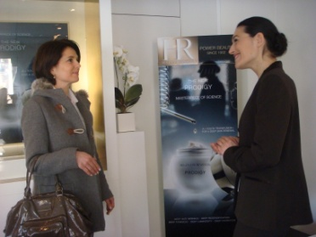
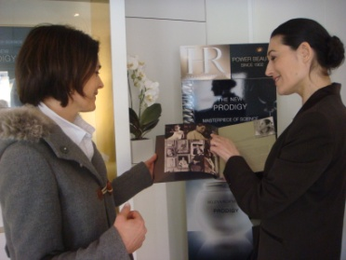
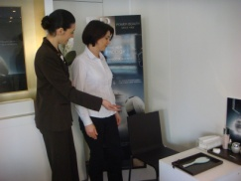
WELCOME
WHAT TO DO
Stand in front of the customer.
Smile.
Hold the brand book (or the iPad) and run through the
brand photos with the customer, presenting the brand message.
At this time, invite her to be seated
WHAT TO SAY
Good morning/afternoon madam, welcome to HR, the brand with over 100 years of anti-aging expertise.
It was created by an extraordinary woman, Helena Rubinstein, who invented the 1st cosmetic skincare treatments.
She was certain that beauty gives power and that each woman who gives herself the right tools, can be beautiful. We still believe in this "Power Beauty" today.
Our products are developed to the very highest standards. We have an exceptional partnership with LaClinic-Montreux, in Switzerland, which enables us to develop skincare on the very boundary of aesthetic medicine.
I would like to invite you to take a personalised skin diagnosis as you might do in a cosmetic clinic, both on the skin surface and deeper down.

Slide 3
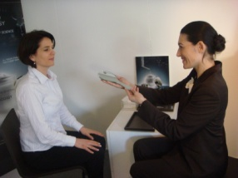
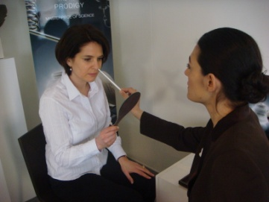
DIAGNOSIS
WHAT TO DO
Invite the customer to be seated.
Ask if she would like you to take her coat or her shopping bags if she is carrying several items.
Explain what the diagnosis will include.
Make her feel comfortable.
Give her the mirror and ask her what she would like to improve about her face today.
Stand behind her both to see what she sees in the mirror and to allow her to answer. Listen to her. Remember what she says.
Be attentive.
Smile. Be pleasant.
Ask her the following questions to gain more information.
To finish, summarise the customer's needs by using the stylus pen to point out the various zones on the face, without touching them.
Present the suitable routine and suggest that she tries the products on her hand.
WHAT TO SAY
Would you like to take a seat so that we can carry out your diagnosis?
May I take your coat?
In order to carry out your personalised diagnosis and recommend the products that match your needs, I am going to ask you a few questions.
Please hold this mirror. When you see yourself in it, can you tell me what you would like to improve about your face today?
What about the eye contour area?
What is your current skincare routine? What kinds of products do you use daily?
What texture do you prefer for your daily skincare? A light cream texture or one that is richer?
With regards to your make-up, what complexion result do you prefer? (natural protection/long-wear/rejuvenating).
You have told me that your concerns are XXXXXXX. In order to respond to these overall anti-aging issues, I would like to recommend the Prodigy routine.
Would you like to try it on your hand?

Slide 4
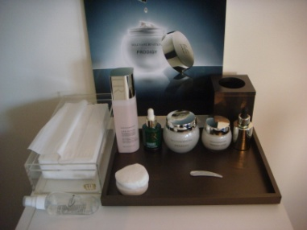
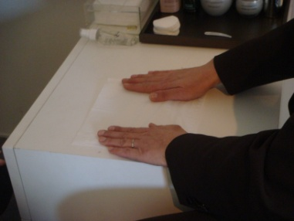
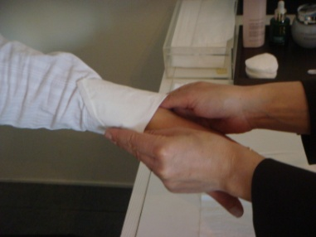
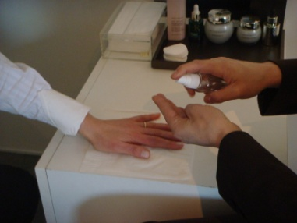
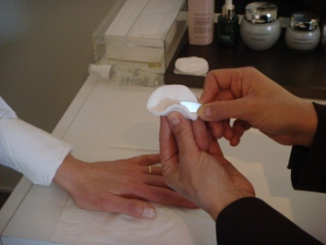
PRODUCT RECOMMENDATIONS
WHAT TO DO
Go and fetch the testers and accessories (sanitiser, cotton pads, tissues, spatula(s), rubbish bin) if they are not already available.
Place the testers in order of use on the tray or pad and bring it to the customer: suitable lotion + serum + cream + eye contour + foundation.
Each time the tester is used, position it back in the same order, turned towards the customer, with its stopper replaced.
Unfold and place a tissue in front of the customer.
Take a second tissue and fold it elegantly, to protect the customer's sleeve.
Sanitise your hands and the spatula.
WHAT TO SAY
So here is the full routine that I'm recommending for you to meet the concerns you explained to me.
I'm going to ask you to place your hand on this tissue so that you are comfortable while we try out the textures.

Slide 5
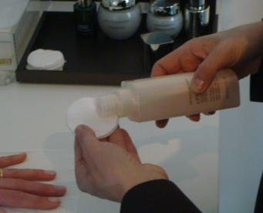
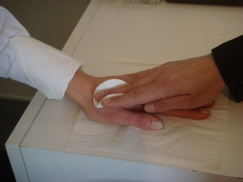
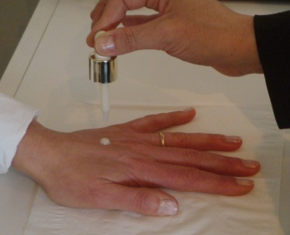
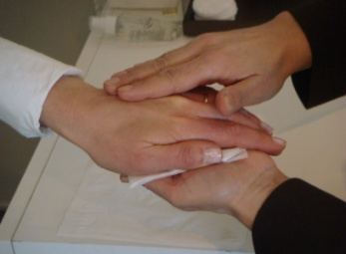
PRODUCT RECOMMENDATIONS
WHAT TO DO
Talk to the customer while applying the product to avoid wasting time.
Present the lotion to the customer.
Take a cotton pad and soak it with lotion.
Wipe the cotton pad soaked in lotion over the outer surface of the hand without touching the wrist or the fingers!
Present the serum to the customer in an elegant manner so that she can read the name while you are talking.
Apply a single drop of the serum onto the customer's hand, ensuring that the dropper does not touch her skin. Close the bottle and place it back in its position.
Place Prodigy Powercell serum back on the tray, then ensure the serum penetrates into the skin.
WHAT TO SAY
In order to prepare your skin to discover the Helena Rubinstein textures, I am first going to use the XXX lotion. This is an essential step in your face care routine because it perfects make-up removal and will both prepare your skin and allow the serum to penetrate better.
I'm now going to apply a drop of Prodigy Powercell serum. As we only use the most concentrated and highest performance active ingredients, just a few drops are enough for visibly younger-looking skin. Prodigy Powercell serum is a concentration of active ingredients that will penetrate deep inside your skin and act on the three major age-defying mechanisms:
Cellular regeneration, tissue repair and defence against free radicals. Its texture allows for complete and total penetration.
Apply this serum in the morning and evening to cleansed skin, avoiding the eye contour, in horizontal movements from the inside to the outer edge of the face.
In just 5 days, the skin is visibly smoother and more radiant.

Slide 6
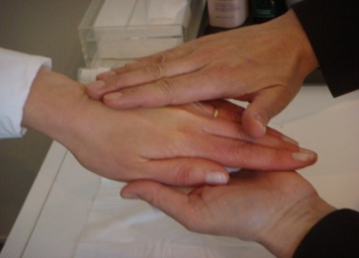
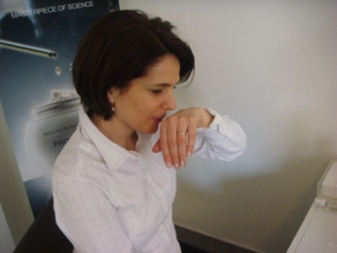
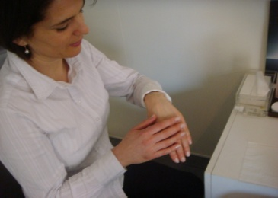
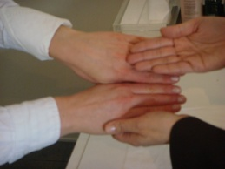
PRODUCT RECOMMENDATIONS
WHAT TO DO
Next, present Prodigy cream to the customer in the same elegant manner.
Open the jar, take a clean spatula from its individual sachet or a spatula that you have sanitised in front of the customer and remove a small amount of cream.
Apply to the customer's hand then place the jar back on the tray.
Massage in as required.
If the customer is looking for a specific product, insist on this product and the results it delivers, while including it as part of the routine: serum + cream + eye contour + foundation.
Invite the customer to smell and touch her hand to enjoy the velvety skin effect.
Ask her to compare with her other hand to see the difference.
WHAT TO SAY
In order to get maximum benefit from this global age-defying routine, all you need to do is apply Prodigy, the ultimate global age-defying treatment, and the Helena Rubinstein signature for the last 10 years. It is a prodigious anti-aging concentrate, which, just as sap gives life to the heart of the plant, will provide your skin with a real transfusion of youth from deep within. The skin is firm, younger and more radiant.
This global anti-aging treatment will meet your needs perfectly, and should be used morning and evening after the serum on the face, avoiding the eye contour.
Its texture and fragrance are unique. What do you think?

Slide 7
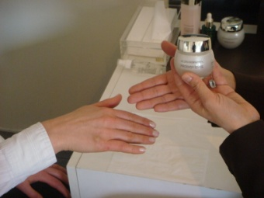
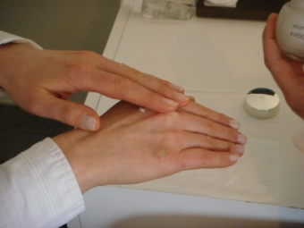
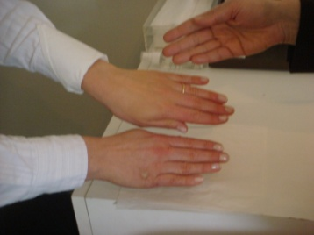
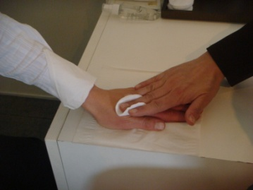
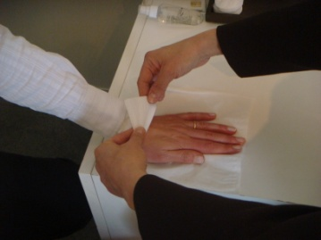
PRODUCT RECOMMENDATIONS
WHAT TO DO
Suggest that the customer tests the texture of the eye contour. If she agrees, apply a tiny amount of product onto her other hand and let her spread the texture herself.
Finally, wrap up with Prodigy Powercell foundation.
Suggest that the customer tries it on the first hand (the one where you applied the face care products) Use a universal shade such as 23.
Place a small amount of foundation on the back of the customer's hand, ensuring that the dropper does not touch it.
Invite the customer to smell and touch her hand to enjoy the result, then invite her to compare her two hands.
When you have finished the texture application, if you have applied the foundation to the customer's hand, take a cotton pad, soak it in lotion and wipe over her hand to remove the foundation.
Remove the protective tissue from her sleeve.
WHAT TO SAY
The skin around the eye contour is much thinner than it is on the face. This area is also under strain from facial expressions, so that is why the product you apply to this fragile zone must be specially adapted. In your case, the ideal product is Prodigy Eyes balm, to achieve an anti-aging and smoothing effect, and it should also be used morning and evening.
Did you know that there are other very simple and complementary techniques you can use to leave your skin looking smooth, young, radiant and fresh?
You can enhance your complexion while prolonging the benefits of your skincare routine by using Prodigy Powercell foundation.
Right from application, you will love the ultra natural bare skin effect that will leave your skin feeling comfortable all day long, and looking smooth and rejuvenated.

Slide 8
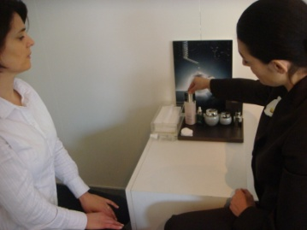
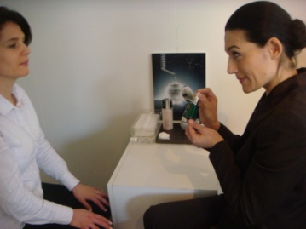
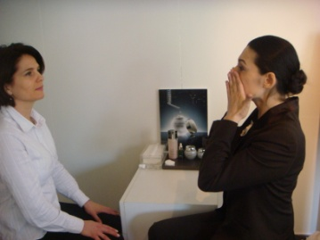
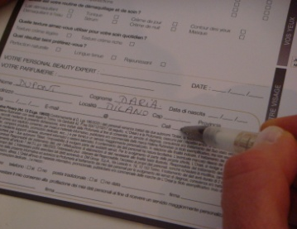
PRODUCT RECOMMENDATIONS
WHAT TO DO
Recap and conclude.
Line up the various products in order of use in front of the customer.
Point to each product when you talk about it, and demonstrate the application techniques.
Answer any questions she may have (see training file).
Fill in the diagnosis and products sections on the prescription card (or iPad)
Do not forget the conclusion phrase, which is essential to trigger the act of purchasing.
WHAT TO SAY
The suitable skincare routine for you Madam is therefore the Prodigy routine, to provide you with global solutions for your anti-aging needs, whether deep down or on the skin surface:
Each morning and evening after cleansing, soak a cotton pad with XXX lotion and apply to the face. Then apply a few drops of Prodigy Powercell serum to your fingers, and smooth over the face in horizontal movements from the centre of the face working outwards, avoiding the eye contour.
Then use a spatula to remove a small amount of Prodigy cream and apply to your face and neck in upward smoothing movements. Use the whole surface of your hand, starting on the neck and working up to the forehead.
For the fragile eye contour area, apply a small amount of Prodigy Eyes balm with the tip of the index and middle fingers, starting from the inner eye and working outwards.
Finally, in the morning you can further enhance the benefits of your routine by using a few drops of Prodigy Powercell foundation.
What do you think?
What would you like to take with you today?
or What would you like to purchase today?

Slide 9
MANAGING PRICE OBJECTIONS
WHAT TO DO
In case of any questions about price:
WHAT TO SAY
Our skincare is truly exceptional.
Our products are developed to the very highest standards. We have an exceptional partnership with LaClinic-Montreux, which enables us to develop skincare on the very boundary of aesthetic medicine.
In addition, we only use highly concentrated active ingredients, selected for their performance.
At Helena Rubinstein, our textures are exceptional, as you have seen.
Our products are designed for demanding women, who are prepared to give themselves the means to look beautiful.

Slide 10
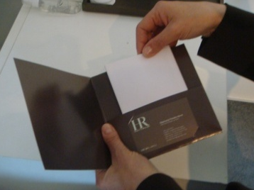
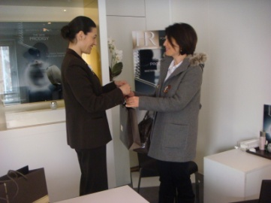
CLOSING A SALE
WHAT TO DO
When the customer has made her choice, go and prepare her products.
Choose suitable samples. Prepare a sample of products that have been recommended but not purchased, prioritizing the must-haves.
E.g. if the customer purchases Prodigy cream, include Powercell and Prodigy Eyes cream as samples.
The samples must be explained: what they are, how to use them.
Suggest that the customer becomes a member of the customer file. Ask her to fill in the CRM file or fill it in for her (or fill in the file for her using the iPad).
Immediately ask if she would like to do a 15-minute Prodigy Beauty Intervention or a Focus or suggest that she makes an appointment for another day.
Thank her and reassure her in her choice of products.
Go with the customer to the cash register, give her the products, give her your business card and explain that you will back at the point of sale another time.
Go with her to the exit and smile when she leaves.
WHAT TO SAY
Very good, I am now going to prepare your products.
Here are your products. I would also like to include these samples of XXXX and YYYY so that you can get to know these products at home.
XXX is used...apply the…(same for sample YYY).
I am also going to give you your beauty prescription which lists the products that I presented to you today.
Would you like to be one of our privileged customers and receive exclusive offers, such as.... XXXX (describe the benefits)?
I would also like to give you the chance to enjoy a 15-minute Beauty Intervention or a Make-up Focus free of charge, to show how to use your products on your face. When would you be available?
Here are your products, you have made a really excellent choice.
I will be delighted to see you again, I am here until (say when) and will be back again on (give the date). Here is my card, please do not hesitate to call.
Would you like me to call you a taxi?
Goodbye, see you soon.

Slide 11
WELCOME
PRODIGY SCENARIO
PRODIGY CUSTOMER REPEAT PURCHASE
Notes:
11
Click on the active zone to start the film.

Slide 12
WELCOME
WHAT TO DO Stand in front of the customer. Smile. The customer knows what she wants: to purchase her cream and/or her Prodigy balm for eyes. The objective is to meet her request while reassuring her about the new Prodigy. | WHAT TO SAY Good morning/afternoon madam, welcome to HR, the brand with over 100 years of anti-aging expertise. ……………… I see that you know our brand. I would like to thank you for your custom/loyalty to Prodigy.

Slide 13
WELCOME
WHAT TO DO Invite the customer to be seated. | WHAT TO SAY 10 years after its launch, and on the strength of its global success with over a million products sold throughout the world, we have renovated our Prodigy cream as well as the balm for the eye contour. We have improved Prodigy's anti-aging power yet again, while conserving its extremely sensorial formula which made it a success among women. The fragrance and texture remain unchanged. The new Prodigy skincare treatments now benefit from HR innovation, Molecular Bio-Sap, which acts right in the deep dermis to improve skin texture and leave the skin looking intensely younger, smoother and more radiant. Some more good news: the price is still the same. Do you have a few minutes to rediscover the texture with me?

Slide 14
CONTINUED...
WHAT TO DO Invite the customer to be seated. Ask if she would like you to take her coat or her shopping bags if she is carrying several items. Follow the texture discovery stage (see p. 4), focusing on Prodigy Cream and Prodigy Eyes. And follow the 1st scenario, adapting it if needed (e.g. page 7: do not read the 1st paragraph aloud) and ensuring you are more concise and not too slow, because the customer is already familiar with the products. If the customer is in a hurry and/or does not wish to be seated, have her try the texture while standing. For Prodigy cream, sanitise your hands, wipe a cotton pad soaked in lotion over her hand, then apply a small amount of cream. Use suitable application techniques to ensure the product is fully penetrated and then have the customer feel the result. If she doesn't purchase anything, give her a sample of the Cream. | WHAT TO SAY

Slide 15
WELCOME
PRODIGY SCENARIO
CUSTOMER LOOKING FOR A SPECIFIC PRODUCT
In this case, use the first scenario and adapt it slightly. During the recommendation, put the focus on the product she is looking for, while presenting her with a full routine:
(lotion +) serum + cream + eye contour + foundation
Notes:
15
Click on the active zone to start the film.

