Slide 1
Re-PLASTY PRO FILLER
INSTANT RE FILLED AND RE PLUMPED INTERVENTION
15 MINUTES
30 MINUTES

Slide 3
BEAUTY INTERVENTION Re-PLASTY PRO FILLER
EXCLUSIVE PARTNERSHIP WITH LACLINIC MONTREUX
INSPIRATION
The Beauty Intervention Re-PLASTY Pro Filler takes its inspiration from the hyaluronic acid injection sessions practiced at the Swiss clinic Laclinic-Montreux.
Hyaluronic acid injections act to fill wrinkles and restore volume to the parts of the face that are subject to slackening and hollowing.
It combines Filler-Solution, which is highly concentrated in hyaluronic acid of high and low molecular mass, which fills surface wrinkles, and deeper down, LR2412(4%), to boost the metabolism of hyaluronic acid in the skin, with manual re-densifying and filling techniques, which replicate the injection procedure. It involves a healing and/or corrective coating treatment with Re-PLASTY Age Recovery, Re-PLASTY HD Peel Cream or Re-PLASTY Mesolift Cream, depending on the client's needs, for skin that radiates with youth.
INSTANT VISIBLE RESULTS
Correction for wrinkles and facial areas that are subject to hollowing (skeletonization), through the filling of wrinkles and replumping the skin in these hollow areas.

Slide 4
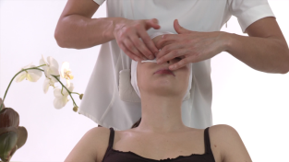
SKIN PREPARATION
MAKEUP REMOVAL
1. LIPS
2. EYES
3. EYES
Wet a cotton square with All Mascaras and gently remove the lipstick, holding the corner of the mouth with one finger. Fold the cotton square on the clean side and continue to remove the makeup. Use a new cotton square if necessary.
Wet a cotton square with All Mascaras and, holding the eyelid with the opposite hand, remove the makeup from the inner edge of the outer corner of the eye. Fold the cotton square and gently brush the underside of the eyelashes from root to end.
Turn over the cotton square and repeat on the top side of the eyelashes. Repeat on the other eye and then gently wipe under the eye.
4. FACE
5. FACE
6. FACE
2 x
3 x
2 x
3 x
2 x
3 x
Mix the texture of the makeup removal cream to make it more fluid. Face contour sculpting: brush the face with your palms from the chin to the forehead and back down on each side.
Invigorating recovery: With hands placed on each side of the neck, stimulate the neck by making circular motions, applying pressure.
Proceed in the same way in the jaw and cheek area, moving toward the external contours of the face.

Slide 5
SKIN PREPARATION
MAKEUP REMOVAL
7. FACE
8. MOUTH
9. LOTION
2 x
3 x
2 x
3 x
T Zone: apply pressure with the pads of your fingers, separating the fingers in the center of the eyebrows and stopping at the temples. Next, stimulate the forehead using spiral motions moving from the center toward the temples. Move down on the outside.
Energize the perimeter of the mouth by making circular smoothing motions up to the joint of the jaw.
Wet 2 cotton squares with the Lotion. Make alternating upward smoothing motions from neck to forehead.
10. LOTION
11. DRYING
12. END
Do this on one side of the face, then the other.
Dry by pressing 2 Kleenex to the skin, folded in 4.
End of makeup removal.

Slide 6
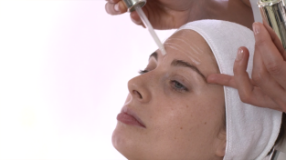
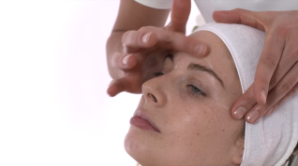
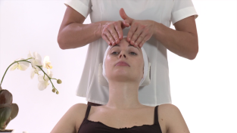
STEP 1 SERUM DEEP WRINKLE FILLING, “INJECTION” OF VOLUME AND ELASTICITY - UPPER PART OF THE FACE
RE-PLASTY PRO FILLER INTENSE WRINKLE CORRECTER AND ELASTICITY RESTORER
1. APPLICATION
2. STAGGERING
3. UPPER FACE
2 x
3 x
Apply the serum using the tip of the syringe along the most accentuated wrinkles and hollow areas of the skin (upper part of the face). Target the serum along the forehead lines, crow's feet and brow furrows.
Spread the serum with the tip of the index finger over the area to be targeted.
Using the pads of the index and middle fingers (or with 4 fingers closed together over a larger area); pull the furrow from both sides. The fingers are positioned and "stretch" the skin in the opposite direction to the wrinkle.
Repeat this technique on each wrinkle.
4. UPPER FACE
5. UPPER FACE
6. UPPER FACE
2 x
3 x
2 x
3 x
2 x
3 x
Lift the skin above the furrow between the balls of the thumb and the pads of the index and middle fingers. Move the fingers along the wrinkle while holding the fold in place, performing a series of gliding pinches.
Repeat this technique on each wrinkle.
Position the fingers vertically in between the eyebrows then stretch toward the middle of the forehead. Position the fingers diagonally on the temples then stretch toward the hairline.
Keep the fingers closed, then using the length of the fingers, gently and gradually press the skin while pulling upward to restore volume. Position the fingers vertically flat along the forehead then stretch out toward the hairline.

Slide 7
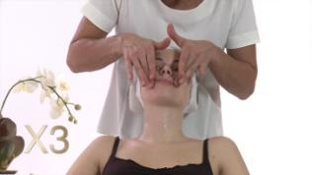
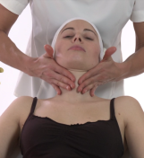
STEP 1 SERUM DEEP WRINKLE FILLING, “INJECTION” OF VOLUME AND ELASTICITY - LOWER PART OF THE FACE
RE-PLASTY PRO FILLER INTENSE WRINKLE CORRECTER AND ELASTICITY RESTORER
1. APPLICATION
2. STAGGERING
3. LOWER FACE
2 x
3 x
Apply the serum using the tip of the syringe along the most accentuated wrinkles and hollow areas of the skin (lower part of the face). Target the serum along the cheeks under the cheekbones, on the nasal-labial furrow, on the upper lip and the neck wrinkles.
Spread the serum with the tip of the index finger over the area to be targeted.
Using the pads of the index and middle fingers (or with 4 fingers closed together over a larger area); pull the furrow from both sides. The fingers are positioned and "stretch" the skin in the opposite direction to the wrinkle.
Repeat this technique on each wrinkle.
4. LOWER FACE
5. LOWER FACE
6. LOWER FACE
2 x
3 x
2 x
3 x
2 x
3 x
Lift the skin above the furrow between the balls of the thumb and the pads of the index and middle fingers. Move the fingers along the wrinkle while holding the fold in place, performing a series of gliding pinches.
Repeat this technique on each wrinkle.
Using the length of the fingers, gently and gradually press the skin while stretching toward the top to restore volume. Position the fingers diagonally under the cheekbones, then stretch out while lightly lifting the skin, rolling it in the fingers.
Position the length of the index and middle fingers along the nasal-labial furrows, raise the furrow from below by lightly rolling the fingers toward the outer part of the furrows. Using the pads of the index fingers, joined together above the upper lip, roll the fingers, gently lifting the outer edge of the lip. Position the fingers diagonally on both sides of the neck, then use the length of the fingers to roll and lift it gently.

Slide 8
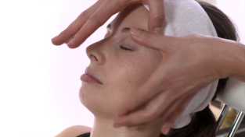
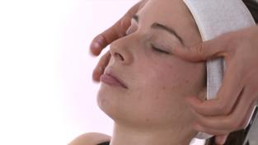
STEP 2 EYE TREATMENT EYE CONTOUR ANTI-FATIGUE LIFTING
Re-PLASTY EXTREME EYE WAKE-UP GEL
1. EYES
2. EYES
3. EYES
2 x
3 x
2 x
3 x
2 x
3 x
Apply the eye product to the eye area by simultaneous smoothing strokes with your index and middle fingers.
Criss-cross: using the pads of your thumbs, alternate with several horizontal smoothing strokes under the eye from the inner corner to the outer corner.
Alternate vertical smoothing strokes on the crow's feet.
4. EYES
5. EYES
6. EYES
2 x
3 x
2 x
3 x
2 x
3 x
Criss-cross mesh: alternate your thumbs in criss-cross strokes with applied pressure from the upper eyelid to the center of the forehead.
Pressing: Alternate with your thumbs, index fingers and middle fingers under the eye (with the pads of your thumbs).
Retrace the length of the crow's feet with your index and middle fingers.

Slide 9
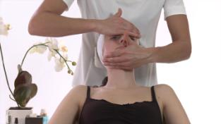
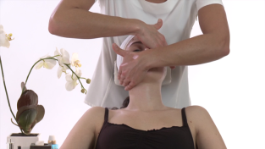
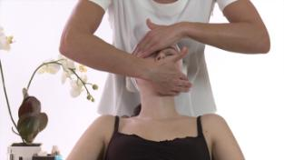
STEP 3 FACE TREATMENT CICATRIZING AND/OR CORRECTIVE NAPPAGE
Re-PLASTY AGE RECOVERY Accelerated repair night care (or HD PEEL, or MESOLIFT)
1. APPLICATION
2. PRESSURE
3. PRESSURE
2 x
3 x
2 x
3 x
Apply the Age Recovery cream (or Re-Plasty Mesolift) to the face.
Place one hand on the forehead and the other on the jaw. Work on one half of the face. Simultaneously press and lift your hands to produce a suction effect.
Move your hand from the forehead to the temple and the hand on the face to the outer contours, 3 x on each line. Move your hand back up from the cheek on an upper level and repeat the suction pressure on each line.
4. PRESSURE
5. SMOOTHING
6. END
2 x
3 x
2 x
3 x
Your hand placed on the frontal bone retraces the movement of the other hand each time during the treatment. Switch hands and repeat the “suction” pressure on the other side.
Stroke the face with opening movements with the entire surface of your hands.
Then glide over both sides of the neck.

Slide 10
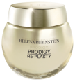
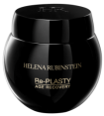
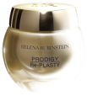
COMPLEMENTARY PRODUCTS RE-PLASTY PRO FILLER
HR GLOBAL REJUVENATING ROUTINE: for long-lasting, deep-down youthful results
HR MUST HAVE
Re-PLASTY HD PEEL REFINING CREAM
+
OR
+
+
Re-PLASTY PRO FILLER INTENSE WRINKLE CORRECTOR AND ELASTICITY RESTORER
Re-PLASTY MESOLIFT COSMETICS REVIVING EXTREME GEL FOR EYES
Re-PLASTY AGE RECOVERY
ACCELERATED REPAIR
NIGHT CREAM
Re-PLASTY MESOLIFT COSMETICS LIFTING-RADIANCE INTENSE CREAM
HR BEAUTY SECRETS: for an instant rejuvenating effect
OR
PRODIGY POWERCELL FOUNDATION
PRODIGY POWERCELL FOUNDATION

